Slide 1
Signal Recovery Under Perturbations
Eeshan Malhotra
14305R001
Department of Computer Science and Engineering
IIT Bombay

Slide 2
Outline
Introduction
Perturbation in sensing matrix
Problem definition, algorithm and experimental results
Tomographic reconstruction with unknown angles
Problem definition, algorithm and experimental results
Interference among two sparse signals
Framework for improving recovery guarantees
Conclusions and Future Work

Slide 3

Introduction: Compressed Sensing Framework
$y= Φx$
or, $y= ΦΨθ$
Measurement
Mx1
Sensing matrix
MxN
Basis
NxN
Sparse Signal Representation
Nx1
M < N
Typical scenario: $y$, $Φ$, $Ψ$ are known. Recover $θ$ (or $x$).
$$\min_{x}{||y −Φx {||}_{2}\text{ + }λ}|\left|x\right||_{1}$$
In practice: Any of $y$, $Φ$, $Ψ$ may have inaccuracies, or perturbations, or even simply structural properties known
Notes:
Alternative being the constrained formulation of the problem

Slide 4
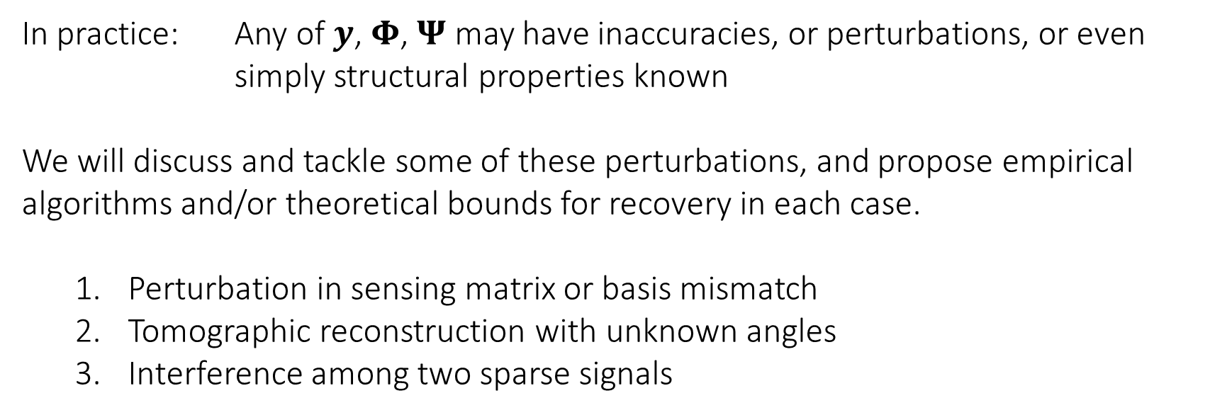

Introduction: Compressed Sensing Framework
$y= Φx$
$$\min_{x}{||y −Φx {||}_{2}\text{ + }λ}|\left|x\right||_{1}$$
In practice: Any of $y$, $Φ$, $Ψ$ may have inaccuracies, or perturbations, or even simply structural properties known
We will discuss and tackle some of these perturbations, and propose empirical algorithms and/or theoretical bounds for recovery in each case.
Perturbation in sensing matrix or basis mismatch
Tomographic reconstruction with unknown angles
Interference among two sparse signals

Slide 5
Perturbed Sensing Matrix
Section 1

Slide 6
Perturbed Sensing Matrix
Sensing matrix 𝚽 may have inaccuracies
Sources: Calibration error, relative motion between instrument and sample
Eg: Frequencies of Fourier matrix in MRI being off by a small amount, tomography projection angles being imperfectly known, etc.
Because of its widespread use, we consider the Fourier matrix for measurement
The framework developed is more general in applicability than the specific cases mentioned

Slide 7
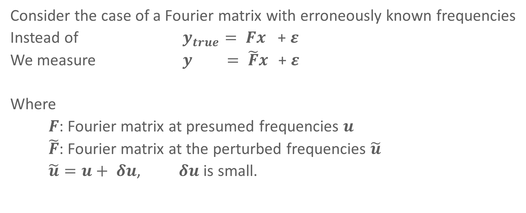
Perturbed Sensing Matrix
Consider the case of a Fourier matrix with erroneously known frequencies
Instead of $y_{true}= Fx$ + $ε$
We measure $y = \tilde{F}x$ + $ε$
Where
$F$: Fourier matrix at presumed frequencies $u$
$\tilde{F}$: Fourier matrix at the perturbed frequencies $\tilde{u}$
$\tilde{u}=u+ δu$, $δu$ is small.

Slide 8
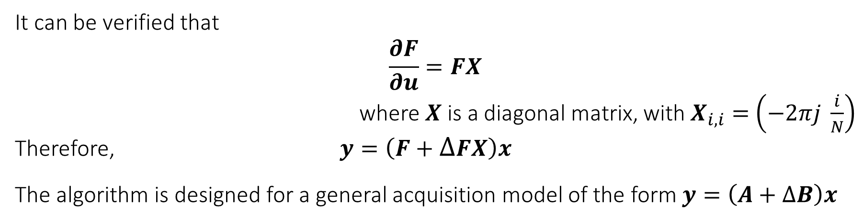
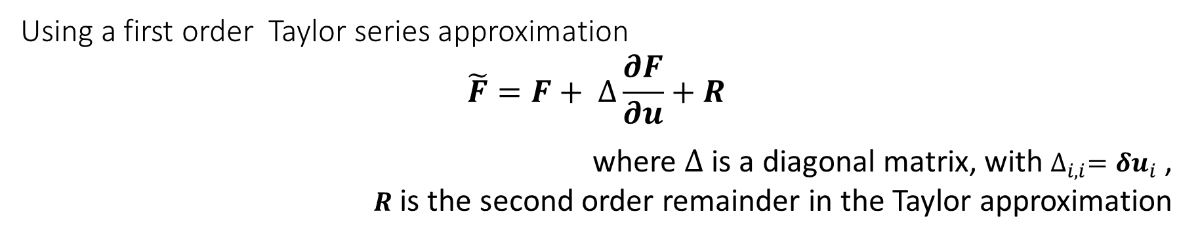
Perturbed Sensing Matrix: Framework
Using a first order Taylor series approximation
$$\tilde{F}=F+ ∆\frac{∂F}{∂u}+R$$
where $∆$ is a diagonal matrix, with $∆_{i,i}={δu}_{i}$ ,
$R$ is the second order remainder in the Taylor approximation
It can be verified that
$$\frac{∂F}{∂u}=FX$$
where $X$ is a diagonal matrix, with $X_{i,i}=$ $\left(−2πj \frac{i}{N}\right)$
Therefore, $y=\left(F+∆FX\right)x$
The algorithm is designed for a general acquisition model of the form $y=\left(A+∆B\right)x$

Slide 9

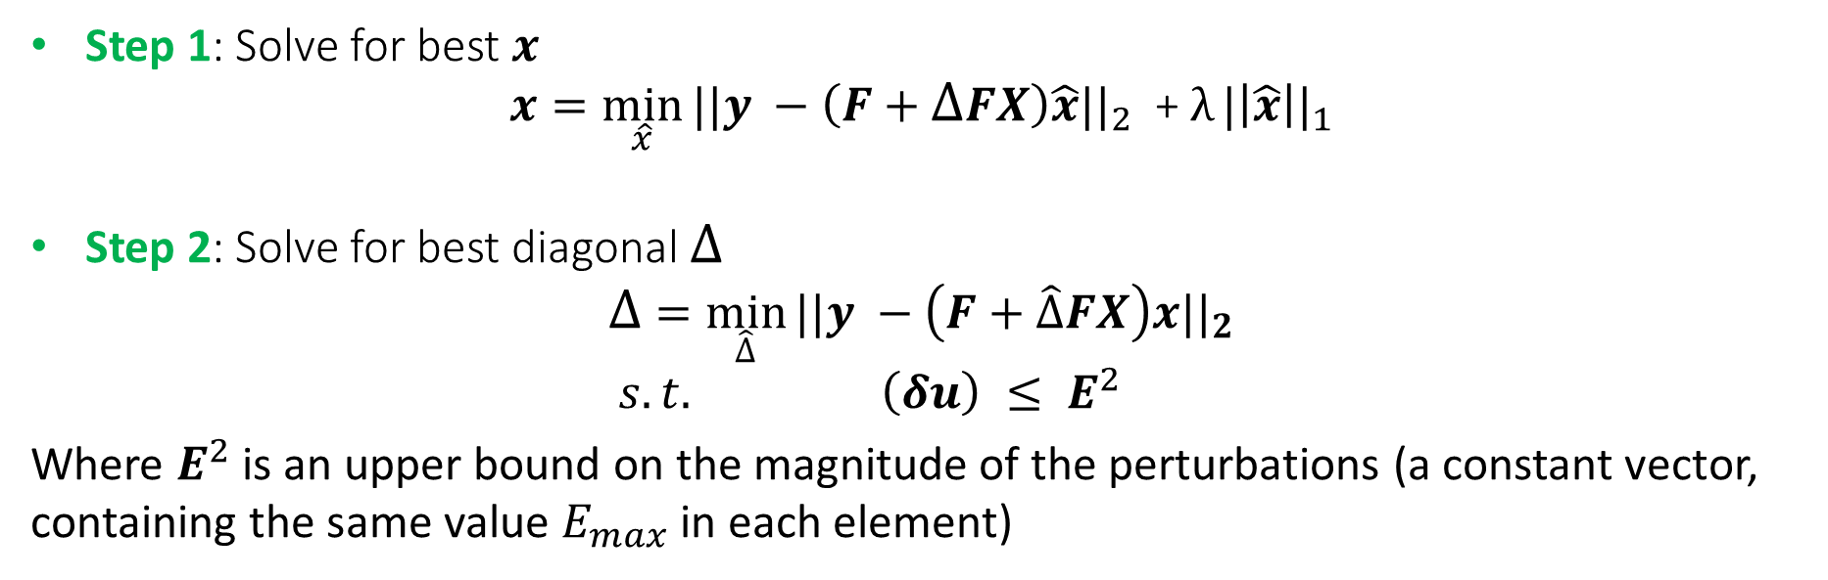
Perturbed Sensing Matrix: Algorithm
$$y=\left(F+∆FX\right)x$$
We use a two-step, alternating algorithm, where we iterate multiple times over two optimization problems – each one solved using well-known convex optimization methods
Step 1: Solve for best $x$
$$x=\min_{\hat{x}}{||y −\left(F+∆FX\right)\hat{x}{||}_{2}\text{ + }λ}|\left|\hat{x}\right||_{1}$$
Step 2: Solve for best diagonal $∆$
$$∆ =\min_{\hat{∆}}{||y −\left(F+\hat{∆}FX\right)x{||}_{2}}$$
$s.t. \left(δu\right) ≤ E^{2}$
Where $E^{2}$ is an upper bound on the magnitude of the perturbations (a constant vector, containing the same value $E_{max}$ in each element)
Notes:
Initialize \delta to 0
Iterate till convergence

Slide 10

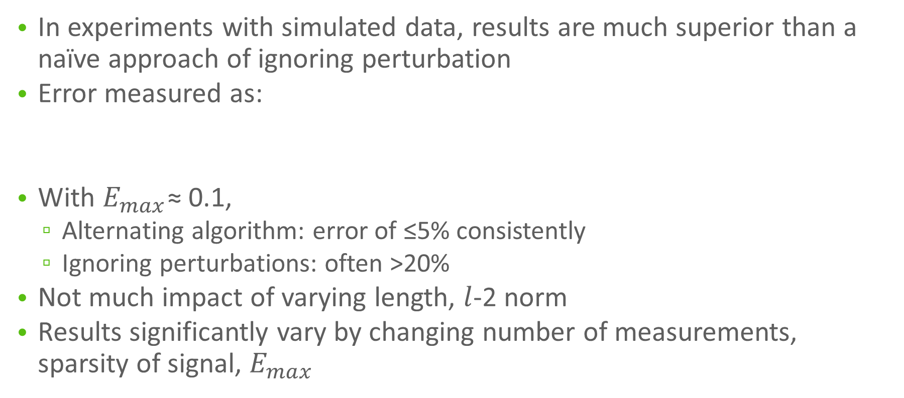
Perturbed Sensing Matrix: Results
In experiments with simulated data, results are much superior than a naïve approach of ignoring perturbation
Error measured as:
With $E_{max}$≈ 0.1,
Alternating algorithm: error of ≤5% consistently
Ignoring perturbations: often >20%
Not much impact of varying length, $l$-2 norm
Results significantly vary by changing number of measurements, sparsity of signal, $E_{max}$

Slide 11
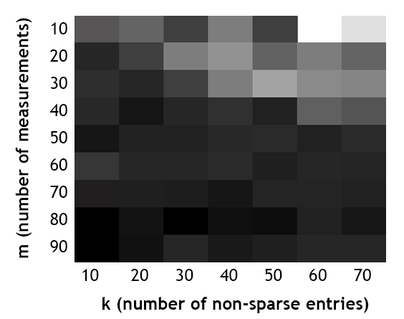
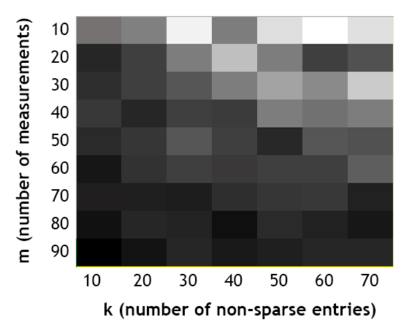
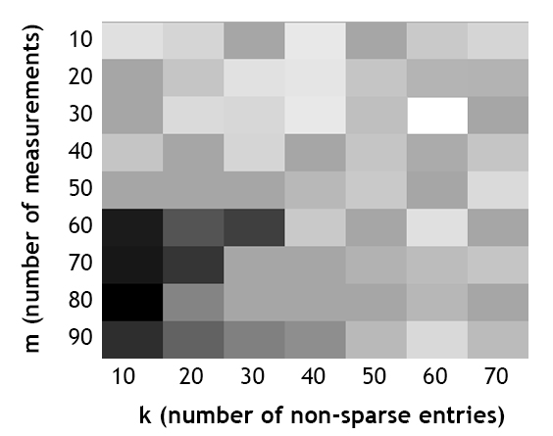



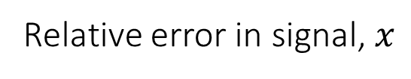
Perturbed Sensing Matrix: Results
Relative error in signal, $x$
(Darker cells denote lower fractional error)
$$E_{max}=0.01$$
$$E_{max}=0.1$$
$$E_{max}=0.5$$

Slide 12

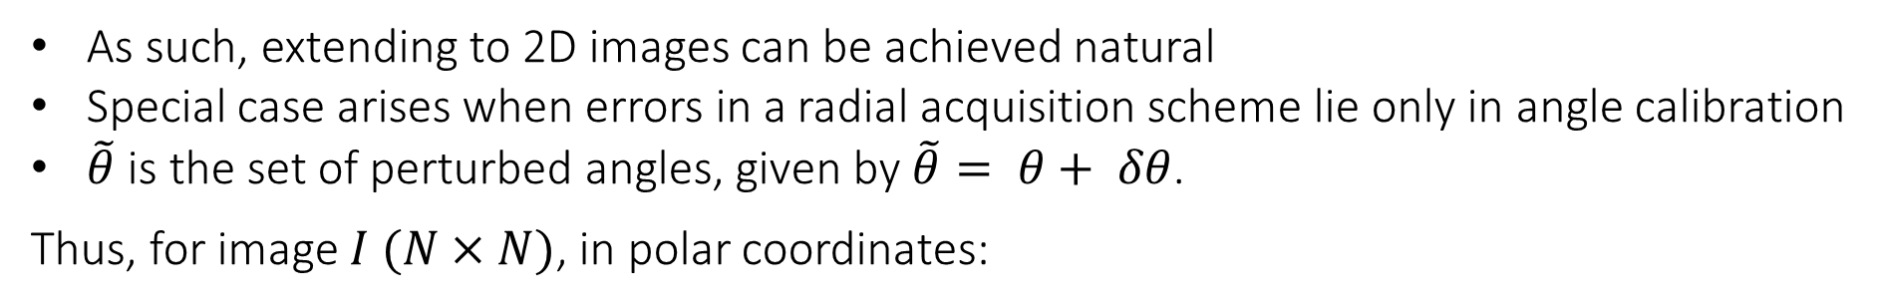
Perturbed Sensing Matrix: 2D recovery
As such, extending to 2D images can be achieved natural
Special case arises when errors in a radial acquisition scheme lie only in angle calibration
$\tilde{θ}$ is the set of perturbed angles, given by $\tilde{θ}= θ+ δθ$.
Thus, for image $I (N×N)$, in polar coordinates:
Again, using a Taylor’s series approximation,
Which is also gives an acquisition model of the form $y ≈(A+ ∆B)x$
Notes:
Talk about the error in frequencies becoming large even if error in \theta is small

Slide 13
Tomographic Recovery with Unknown View Angles
Section 2

Slide 14
Perturbed Sensing Matrix: 2D recovery
As such, extending to 2D images can be achieved natural
Special case arises when errors in a radial acquisition scheme lie only in angle calibration
$\tilde{θ}$ is the set of perturbed angles, given by $\tilde{θ}= θ+ δθ$.
Thus, for image $I (N×N)$, in polar coordinates:
Again, using a Taylor’s series approximation,
Which is also gives an acquisition model of the form $y ≈(A+ ∆B)x$
Notes:
Talk about the error in frequencies becoming large even if error in \theta is small

Slide 15
Thank You

